Slide 1
THE EVIDENCE SANDWICH MODEL
Research priority setting exercises: how to reach and address needs of disadvantaged groups
Dr. Soumyadeep Bhaumik
BioMedical Genomics Centre, Kolkata
drsoumyadeepbhaumik@gmail.com
No Competing Interests & Not Funded

Slide 2
Agenda of Medicine…
‘We live in a world with infinite possibilities. Hearts are transplanted, DNA is decoded, and new medical discoveries are made every day. Yet we continue to be stymied by how best to reach those in resource-poor settings with the most basic care and medicines that we take for granted. What could break through this conundrum?’
Bill Frist & Richard Sezibera. The Lancet, 2009;374:1485-1486
Notes:
Factors impeding the success of scale-up that emerged from the key informant interviews, and which are areas for future investigation, include: complexity of the intervention and lack of technical consensus; limited human resource, leadership, management, and health systems capacity; poor application of proven diffusion techniques; lack of engagement of local implementers and of the adopting community; and inadequate integration of research into scale-up efforts.

Slide 3
Formulating Research Agenda
Practical
Evidence
Equity
Research Agenda
Clinical Expertise
Evidence
Patient Preferences
Evidence Informed Medicine
Epistemic Deliberation over priority clinical and public health questions.. .
Systematic Review and Meta-analyses on priority questions
Notes:
Factors impeding the success of scale-up that emerged from the key informant interviews, and which are areas for future investigation, include: complexity of the intervention and lack of technical consensus; limited human resource, leadership, management, and health systems capacity; poor application of proven diffusion techniques; lack of engagement of local implementers and of the adopting community; and inadequate integration of research into scale-up efforts.

Slide 4
What is needed more …
Acceptability
Affordability
Answerability
Applicability
Deliverability
Equity
Existing Research Capacity
Feasibility
Potential Effect on disease burden
Potential for further research
Impact

Slide 5

Evidence Sandwich Model
DEFINING OBJECTIVES, MARKING DOMAINS AND ELUCIDATING CRITERIA
EVIDENCE
PRIORITY SETTING EXERCISE

Slide 6
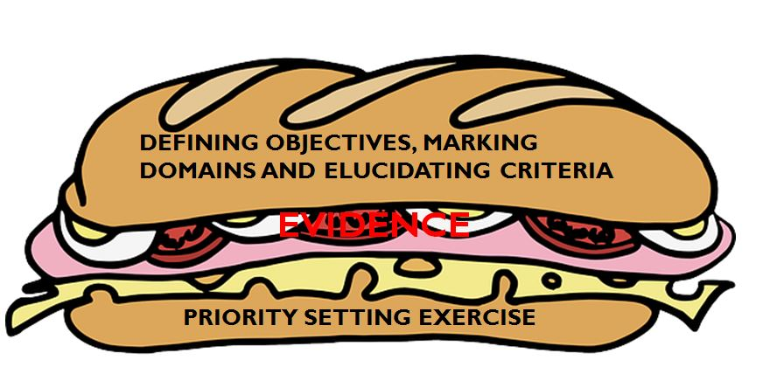
DEFINING OBJECTIVES, MARKING DOMAINS AND ELUCIDATING CRITERIA
EVIDENCE SANDWICH MODEL
Role of Epistemic community to set the ball rolling…

Slide 7
Defining Objectives/ Scope of Priority Setting Exercise
To review existing evidence in relation to the problem identified
To prioritize research questions that need to be answered in relation to laboratory, clinical studies, treatment trials and prevention approaches.
To develop plans for collaboration, networking and advocacy in relation to research, policy and training
To identify potential bottlenecks in the actual implementation of research including availability of funds
To limit the scope and limits of priority setting exercise
Notes:
Macro-level: identifying and prioritising broad topic areas for the group to define the general direction of the group in a specific field
Meso-level: identifying and prioritising research questions for the group. The questions might be broad and narrow depending on the data (qualitative or quantitative) derived from the exercise
Micro-level: identifying and prioritising focused clinical questions for systematic reviews. The questions are constructed to be addressed either by a Cochrane Systematic Review or Cochrane Overviews of Review. However, this is the most difficult one as there are still a lot of open methodological questions how we best can translate uncertainties of our stakeholders into focused questions for systematic reviews.

Slide 8
Consideration’s for setting priorities within a domain
Burden of Disease
Status of diagnostic/treatment options – their efficacy, adverse event profile, consensus on its use in practice or guidelines
Potential availability of better diagnostic / treatment options
Affordability of available diagnostic / treatment options
Needs of Health Systems
Feasibility and Implementation ability
Existing Research Capacity (including human resources)
ONCE ALL THESE ARE CLARIFIED ONLY THEN…..

Slide 9
Rapid Systematic Review & evidence mapping
EVIDENCE SANDWICH MODEL
What is already known and what is not ?

Slide 10
Elucidating Research Questions
Identify the key stakeholders(including decision makers) affected by the results of this research agenda?
Stakeholder engagement is long-term.
Derive research questions from stakeholders as well as from data sources including from systematic reviews on relevant topics.
Research questions should not be only on clinical/public health safety and efficacy issue but also on implementation , ethics , training, capacity building etc.
Considerations defined previously to be refined

Slide 11
Evidence in Priority Setting Exercise
Formulation of PICO
Population of interest
Search For Evidence
Analysis and Review Brief
Intervention to be experimented/ evaluated
Control to act as a comparison
Outcomes of importance
Comprehensive Search such that no research evidence is missed
Protocol
Screening through studies to obtain further studies for analysis
Grey Literature Search
Data Collection & analyses
Interpretation
Summary of Finding & Review Brief

Slide 12
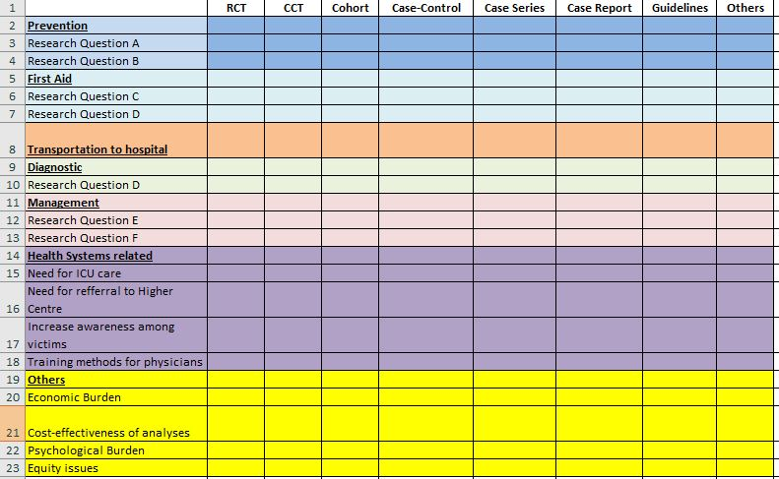
Evidence Mapping

Slide 13
Priority setting exercise deliberative process & group discussions
EVIDENCE SANDWICH MODEL
Making research practical & relevant
Setting priorities

Slide 14
Priority Setting Process
All evidence summaries and priority questions to be send to stakeholders and open to modification
Survey of Priorities from patients/ affected groups
Thematic session with slots for basic science, clinical medicine, laboratory medicine, clinical researchers & identified interdisciplinary work
Final session consensus on priority recommendations, discussion on potential collaborations & advocacy
Qualitative Lectures on community experiences

Slide 15
Within a session …
Deliberative quest
To ensure voice of all stakeholders are heard
Group Discussion
With the aim of reaching consensus on priorities
Translating between different spheres of expertise
Use foresight and Don’t Shy from stepping back.

Slide 16
Successful Priority Setting Needs Having the Sandwich Again
DEFINING OBJECTIVES, MARKING DOMAINS AND ELUCIDATING CRITERIA
EVIDENCE
PRIORITY SETTING EXERCISE

Slide 17
Why the Evidence Sandwich Model ?
Broad format with adaptability .
Structured to guide process.
Collaborative & Transparent .
Common ground with sense of ownership .
Introspection within at every step.
Needs of disadvantaged groups addressed.
Ensures Equity .
Remains open-ended.
Ensures balance between best science versus trade-offs .

Slide 18


More Resources :
www.capsmg.cochrane.org
drsoumyadeepbhaumik@gmail.com
DrSoumyadeepB
Dr. Soumyadeep Bhaumik
BioMedical Genomics Centre
Kolkata, India

